Slide 1



Understanding The Actuarial Report
All the Geeky Stuff You Never Wanted to Know…
Small Cities Organized Risk Effort (SCORE)
Board of Directors Meeting
Thursday, October 26, 2017
Mike Harrington, FCAS, MAAA
President, Actuarial Consulting
Bickmore
This document was designed for discussion purposes only and is not intended to present detailed information on our analysis and findings. It is incomplete, and not intended to be used, without the accompanying oral presentation and discussion.

Slide 2
Actuarial Disclosure
Numbers are fun. They make the world go around. I know you think you understand what you thought I said. But I'm not sure you realize that what you heard is not what I meant. I know you think you understand what you thought I said. But I'm not sure you realize that what you heard is not what I meant. I know you think you understand what you thought I said. But I'm not sure you realize that what you heard is not what I meant. Numbers are fun. They make the world go around. I know you think you understand what you thought I said. But I'm not sure you realize that what you heard is not what I meant. I know you think you understand what you thought I said. But I'm not sure you realize that what you heard is not what I meant. I know you think you understand what you thought I said. But I'm not sure you realize that what you heard is not what I meant. I know you think you understand what you thought I said. But I'm not sure you realize that what you heard is not what I meant. I know you think you understand what you thought I said. But I'm not sure you realize that what you heard is not what I meant. I know you think you understand what you thought I said. But I'm not sure you realize that what you heard is not what I meant. I know you think you understand what you thought I said. But I'm not sure you realize that what you heard is not what I meant. Numbers are fun. They make the world go around. I know you think you understand what you thought I said. But I'm not sure you realize that what you heard is not what I meant. I know you think you understand what you thought I said. But I'm not sure you realize that what you heard is not what I meant. I know you think you understand what you thought I said. But I'm not sure you realize that what you heard is not what I meant. I know you think you understand what you thought I said. But I'm not sure you realize that what you heard is not what I meant. I know you think you understand what you thought I said. But I'm not sure you realize that what you heard is not what I meant. I know you think you understand what you thought I said. But I'm not sure you realize that what you heard is not what I meant. I know you think you understand what you thought I said. But I'm not sure you realize that what you heard is not what I meant. I know you think you understand what you thought I said. But I'm not sure you realize that what you heard is not what I meant. I know you think you understand what you thought I said. But I'm not sure you realize that what you heard is not what I meant. I know you think you understand what you thought I said. But I'm not sure you realize that what you heard is not what I meant. I know you think you understand what you thought I said. But I'm not sure you realize that what you heard is not what I meant. I know you think you understand what you thought I said. But I'm not sure you realize that what you heard is not what I meant. I know you think you understand what you thought I said. But I'm not sure you realize that what you heard is not what I meant. Numbers are fun. They make the world go around. I know you think
2

Slide 3
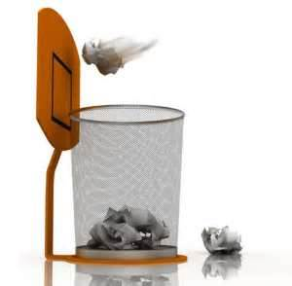


Actuarial Report – Incorrect Uses
3

Slide 4


Topics of Discussion
Actuarial Terminology
Outstanding Liabilities at June 30, 2017
  a.k.a. Reserves
2017-18 Funding Guidelines
  a.k.a. Rates
  But first…
4

Slide 5

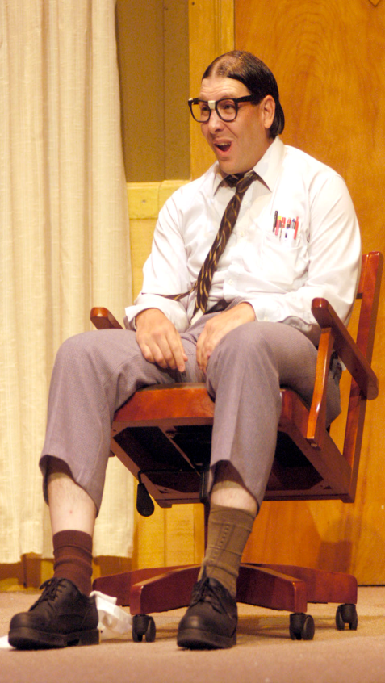


Actuary: #1 Career…Again!
5
5

Slide 6

Actuarial Stereotypes
What do we know about the #1 career in America?
  There are three types of actuaries:
    Those that can count
    Those that can’t count
  An actuary is someone who wanted to be an
  accountant, but didn’t have the personality for it.
  An extroverted actuary looks at your shoes when talking instead of his own shoes.
  An actuary is a place where they bury dead actors…
6

Slide 7



Actuarial Terminology
What Does All This Stuff Mean??
7

Slide 8

Actuaries Love Data
Data needed for an actuarial study:
  Losses (Paid, Incurred, Case, Recoveries, ...)
  Exposures (Payroll, Vehicles, SIRs,...)
  Asset Info (Balance Sheet)
  Budget Info (Income Statement)
  Shoe Sizes, Favorite Ice Cream
  Anything else that may be relevant to making loss estimates
8

Slide 9

Some Fun Terms
Loss – Settlements/Judgments for Liability, Medical/Indemnity for WC
ALAE – Allocated Loss Adjustment
Expenses, consist primarily of legal fees
ULAE – Unallocated Loss Adjustment
Expenses, consist primarily of claims administration expenses
9

Slide 10
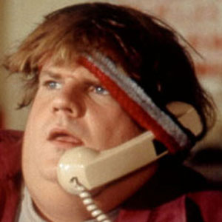
More Lingo
Paid Losses – OK, this is obvious
Case Reserves – Amount unpaid on individual claims, set by adjuster
IBNR Reserves – Amount made up…I mean, calculated with the utmost precision, by the actuary
Incurred / Reported = Paid + Case
Ultimate = Paid + Case + IBNR
i.e. The total cost of claims occurring in a given year!
10

Slide 11

Case vs. IBNR Reserves
Case reserves are determined for individual claims based upon characteristics of the claim
IBNR reserves are determined in total for all claims occurring in a single year based upon development of paid losses and case reserves over time
Case reserves are a very important ingredient in determining the final IBNR reserves
11

Slide 12
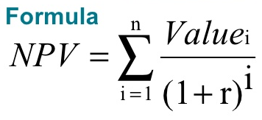
Discounting
Reserve discounting adjusts actuarial
estimates for the time value of money.
  Since you don’t have to pay all the claims today, you can invest assets and generate income from investments.
  This decreases the net cost of claims
Discount rate should be average expected return for the period it takes to pay off claims
  Selected discount rate may be higher than current yield
  …but be realistic!
12

Slide 13

Confidence Levels
The majority of actuarial calculations are done at the “Expected Level” (Average/Central Estimates).
“Confidence Level” estimates are also
provided, which provide a safety
margin above the “Expected Level”.
Describes the degree to which assets are likely to exceed the actual value of loss liabilities after all claims have been settled.
“Expected Level” is approx 55% Conf Level
13

Slide 14

Pooled WC Insurance Program
  Self-Insured Retention of $250,000
    Banking Layer $0 to $25,000
    Shared Layer $25,000 to $250,000
  Claims Administration by York Risk Services
  Excess Insurance through Local Agency Workers’ Compensation Excess Joint Powers Authority (LAWCX)
14

Slide 15


Warning…
Lots of Numbers Ahead!
Calculators May Be Needed
15

Slide 16
Outstanding Liabilities
How Much Do You Owe For Old Claims??
16

Slide 17
Actual versus Expected
  When the prior actuarial report was completed we had an expectation of what would happen to losses as they “develop” over the coming year.
  One of the first steps of each year’s actuarial study is to compare that expectation to what actually happened.
    Losses may develop “favorably” (i.e. more than expected)
    Losses may develop “adversely” (i.e. less than expected)
17

Slide 18

Actual versus Expected – Favorable
18
18

Slide 19
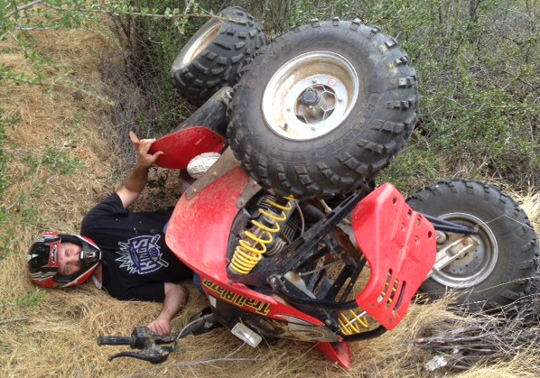
Actual versus Expected – Adverse
19

Slide 20

Actual versus Expected – Favorable
20

Slide 21

Actual vs Expected – Adverse
21

Slide 22
Actual versus Expected
22

Slide 23
Selected Ultimate Loss and ALAE
23

Slide 24
Case Reserves vs IBNR Reserves
24

Slide 25
Outstanding Liabilities
 |  |  | Marginally |  | Recommended Range
 | Expected |  | Acceptable |  | Low |  | Target |  | High |  | Conservative
 |  |  | 70% CL |  | 75% CL |  | 80% CL |  | 85% CL |  | 90% CL
Loss and ALAE | $3,985,000 |  | $4,435,000 |  | $4,627,000 |  | $4,854,000 |  | $5,129,000 |  | $5,495,000
Investment Income Offset | (355,000) |  | (395,000) |  | (412,000) |  | (432,000) |  | (457,000) |  | (490,000)
Discounted Loss and ALAE | $3,630,000 |  | $4,040,000 |  | $4,214,000 |  | $4,421,000 |  | $4,672,000 |  | $5,006,000
Prior Liabilities = $3,211,000 (13.0% Increase driven by a 16% increase in case reserves)
Investment Income assumes 1.5% annual rate of return.
Pool limit is $250K.
25

Slide 26
Outstanding Liabilities
Banking Layer
 |  |  | Marginally |  | Recommended Range
 | Expected |  | Acceptable |  | Low |  | Target |  | High |  | Conservative
 |  |  | 70% CL |  | 75% CL |  | 80% CL |  | 85% CL |  | 90% CL
Loss and ALAE | $358,000 |  | $402,000 |  | $422,000 |  | $444,000 |  | $472,000 |  | $509,000
Investment Income Offset | (8,000) |  | (9,000) |  | (9,000) |  | (10,000) |  | (11,000) |  | (11,000)
Discounted Loss and ALAE | $350,000 |  | $393,000 |  | $412,000 |  | $434,000 |  | $462,000 |  | $498,000
Prior Liabilities = $288,000 (21.5% Increase)
Investment Income assumes 1.5% annual rate of return.
Banking Layer is $0 to $25K.
26

Slide 27
Outstanding Liabilities
Shared Layer
 |  |  | Marginally |  | Recommended Range
 | Expected |  | Acceptable |  | Low |  | Target |  | High |  | Conservative
 |  |  | 70% CL |  | 75% CL |  | 80% CL |  | 85% CL |  | 90% CL
Loss and ALAE | $3,627,000 |  | $4,033,000 |  | $4,204,000 |  | $4,409,000 |  | $4,655,000 |  | $4,985,000
Investment Income Offset | (347,000) |  | (386,000) |  | (402,000) |  | (422,000) |  | (445,000) |  | (477,000)
Discounted Loss and ALAE | $3,280,000 |  | $3,647,000 |  | $3,802,000 |  | $3,987,000 |  | $4,210,000 |  | $4,508,000
Prior Liabilities = $2,923,000 (12.2% Increase)
Investment Income assumes 1.5% annual rate of return.
Shared Layer is $25K to $250K.
27

Slide 28
Inflation
Look On The Bright Side…
28

Slide 29
Gas Prices
29

Slide 30
But…Some Prices Are Decreasing
30

Slide 31
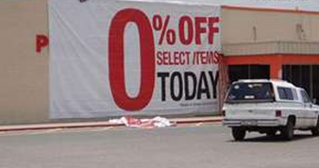
Emphasize Stability
31

Slide 32
Put A Positive Spin on Increases
32

Slide 33
Annual Funding
How Much Do You Need For New Claims??
33

Slide 34
Frequency Trend (Claims per $1 Million of Payroll)
-1.4% Overall Decreasing Trend
34

Slide 35
Severity Trend (Dollars of Loss per Claim)
2.5% Overall
Increasing Trend
35

Slide 36
Loss Rate Trend (Dollars of Loss per $100 of Payroll)
+1.1% Overall
Increasing Trend
36

Slide 37
Calculating Projected Losses
Selected 2016-17 $100K Loss and ALAE Rate |  |  |  | $3.300
Adjusted to 2017-18 Cost Level |  |  |  | 1.011
Adjusted to $250K SIR Level |  |  |  | 1.460
Selected 2017-18 $250K Loss and ALAE Rate |  |  |  | $4.869
Estimated 2017-18 Payroll ($00's) |  |  |  | 220,625
Projected 2017-18 Loss and ALAE |  |  |  | $1,074,000
37

Slide 38
Projected Losses
 |  |  | Marginally |  | Recommended Range
 | Expected |  | Acceptable |  | Low |  | Target |  | High |  | Conservative
 |  |  | 70% CL |  | 75% CL |  | 80% CL |  | 85% CL |  | 90% CL
Loss and ALAE | $1,074,000 |  | $1,279,000 |  | $1,375,000 |  | $1,487,000 |  | $1,626,000 |  | $1,815,000
Investment Income Offset | (82,000) |  | (98,000) |  | (105,000) |  | (114,000) |  | (124,000) |  | (139,000)
Discounted Loss and ALAE | $992,000 |  | $1,181,000 |  | $1,270,000 |  | $1,374,000 |  | $1,502,000 |  | $1,676,000
Rate per $100 of 2017-18 Payroll | $4.50 |  | $5.35 |  | $5.76 |  | $6.23 |  | $6.81 |  | $7.60
Prior Estimate = $868,000 (14.5% Increase)
Prior Rate = $4.27 (5.4% Increase)
Investment Income assumes 1.5% annual rate of return.
Pool limit is $250K.
38

Slide 39
Projected Losses
Banking Layer
 |  |  | Marginally |  | Recommended Range
 | Expected |  | Acceptable |  | Low |  | Target |  | High |  | Conservative
 |  |  | 70% CL |  | 75% CL |  | 80% CL |  | 85% CL |  | 90% CL
Loss and ALAE | $297,000 |  | $348,000 |  | $372,000 |  | $399,000 |  | $434,000 |  | $481,000
Investment Income Offset | (5,000) |  | (6,000) |  | (6,000) |  | (7,000) |  | (7,000) |  | (8,000)
Discounted Loss and ALAE | $292,000 |  | $342,000 |  | $365,000 |  | $393,000 |  | $427,000 |  | $473,000
Rate per $100 of 2017-18 Payroll | $1.32 |  | $1.55 |  | $1.65 |  | $1.78 |  | $1.94 |  | $2.14
Prior Estimate = $264,000 (10.6% Increase)
Prior Rate = $1.30 (1.5% Increase)
Investment Income assumes 1.5% annual rate of return.
Banking Layer is $0 to $25K.
39

Slide 40
Projected Losses
Shared Layer
 |  |  | Marginally |  | Recommended Range
 | Expected |  | Acceptable |  | Low |  | Target |  | High |  | Conservative
 |  |  | 70% CL |  | 75% CL |  | 80% CL |  | 85% CL |  | 90% CL
Loss and ALAE | $777,000 |  | $931,000 |  | $1,005,000 |  | $1,089,000 |  | $1,193,000 |  | $1,335,000
Investment Income Offset | (77,000) |  | (92,000) |  | (100,000) |  | (108,000) |  | (118,000) |  | (132,000)
Discounted Loss and ALAE | $700,000 |  | $839,000 |  | $905,000 |  | $981,000 |  | $1,075,000 |  | $1,203,000
Rate per $100 of 2017-18 Payroll | $3.17 |  | $3.80 |  | $4.10 |  | $4.45 |  | $4.87 |  | $5.45
Prior Estimate = $604,000 (15.9% Increase)
Prior Rate = $2.97 (6.7% Increase)
Investment Income assumes 1.5% annual rate of return.
Shared Layer is from $25K to $250K.
40

Slide 41


Questions ??
Ask an Actuary !
Call 1-800-[(10x)²-2x+34]
41

